Slide 1

DEPARTMENT OF ARTIFICIAL INTELLIGENCE AND DATA SCIENCE
Artificial Neural Networks and Deep Learning: 21ADG64
LA1 - Seminar
“Deep Reinforcement Learning”
Presented By
Advitha Bobba
[1NT21AD005]
Name of the Course Instructor Dr Meenakshi

Slide 2

CONTENTS
Introduction and Motivation
Methodology and Approach
Results and Analysis
Conclusion and Future Recommendations
Demo video of code
Result
References

Slide 3
INTRODUCTION
Reinforcement learning: Imagine an agent learning through trial and error in an environment. It takes actions, receives rewards for good actions and penalties for bad ones, and tries to learn the best course of action to achieve a goal. Think of it like training a pet by rewarding good behavior.
Deep learning: This is a type of artificial intelligence inspired by the structure and function of the brain. It uses artificial neural networks to learn from data, allowing it to identify patterns and make decisions from complex information.
Deep reinforcement learning combines these two. It uses deep learning models to give the agent the ability to perceive and understand complex environments, and reinforcement learning to guide the agent towards taking the best actions to achieve its goals. This allows agents to learn complex tasks by trial and error, without needing someone to program them for every situation.

Slide 4
MOTIVATION
The motive behind the development of deep reinforcement learning is
Automate complex tasks
Handle unstructured data
Efficient decision-making

Slide 5
METHODOLOGY AND APPROACH
Deep reinforcement learning (DRL) works through a cycle of interacting with an environment, learning from rewards, and taking actions.
The breakdown of the methodology is :
Problem Formulation:
Define the problem in terms of an agent interacting with an environment.
Specify the observation space (what the agent can perceive) and action space (what actions the agent can take).
Determine the reward function that provides feedback to the agent's actions.
Model Architecture:
Utilize deep neural networks to approximate the value function.
Common architectures include convolutional neural networks (CNNs) for handling image-based observations and feedforward neural networks for simpler state representations.

Slide 6
Reinforcement Learning Algorithms:
Choose a suitable RL algorithm based on the problem requirements and characteristics.
Some popular DRL algorithms include:
Deep Q-Networks (DQN
Deep Deterministic Policy Gradient (DDPG)
Proximal Policy Optimization (PPO)
Trust Region Policy Optimization (TRPO)
Soft Actor-Critic (SAC)
Twin Delayed DDPG (TD3)

Slide 7
Training Process:
Initialize the neural network parameters randomly or using pre-trained weights
Interact with the environment by selecting actions according to the current policy and observe the resulting state and reward.
Update the neural network parameters using backpropagation to minimize the discrepancy between predicted and observed values or to maximize the expected return.
Evaluation and Improvement:
Evaluate the trained agent's performance on unseen tasks or environments to assess generalization.
Fine-tune hyperparameters and neural network architectures based on performance metrics and domain knowledge.
Consider techniques for improving sample efficiency, such as prioritized experience replay, population-based training, or asynchronous methods.

Slide 8
Deployment:
Deploy the trained agent in real-world applications, either in simulation or directly in the target environment.
Monitor the agent's behavior and performance to ensure safety and reliability.
Continuously update and retrain the agent as needed to adapt to changing conditions or requirements.

Slide 9
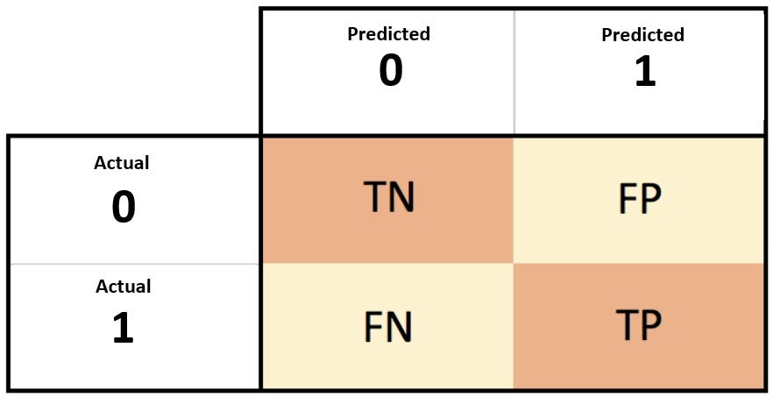
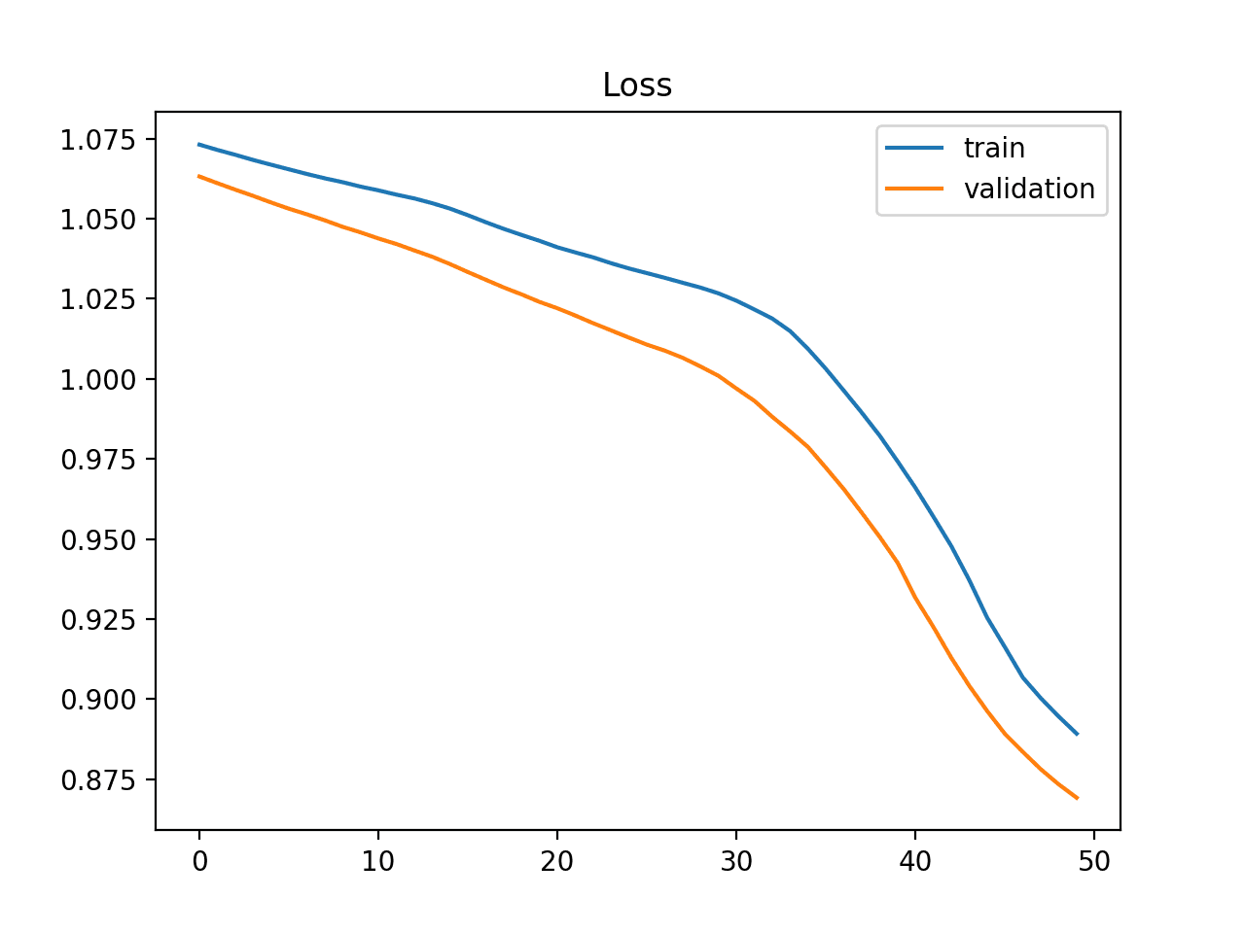
RESULT AND ANALYSIS
Performance Metrics:
Training Curves: Track how performance metrics
change during training epochs.

Slide 10
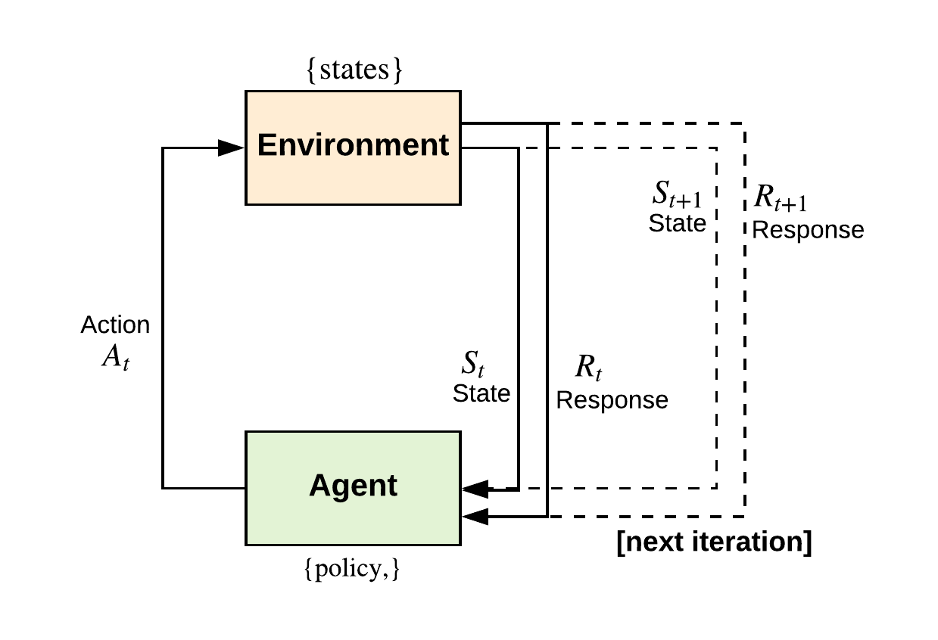
Exploration vs. Exploitation: Ensure balance between trying new actions and exploiting known ones.
Generalization: Test how well the agent adapts to new environments or tasks.
Hyperparameter Tuning: Optimize parameters like learning rate and discount factor for best performance.
Comparative Analysis: Compare performance of different algorithms or settings.

Slide 11
CONCLUSION AND FUTURE RECOMENDATIONS
Advancements : Deep Reinforcement Learning (DRL) has seen significant progress, showcasing its potential in various domains like gaming, robotics, finance, and healthcare.
Complexity Handling : DRL excels in managing complex environments with high-dimensional state and action spaces, previously challenging for traditional methods.
Sample Efficiency : Improving sample efficiency remains crucial, with ongoing research focusing on techniques like experience replay and reward shaping.
Transfer Learning : Enhancing transfer learning capabilities enables DRL agents to apply knowledge gained in one task to solve related tasks efficiently.

Slide 12
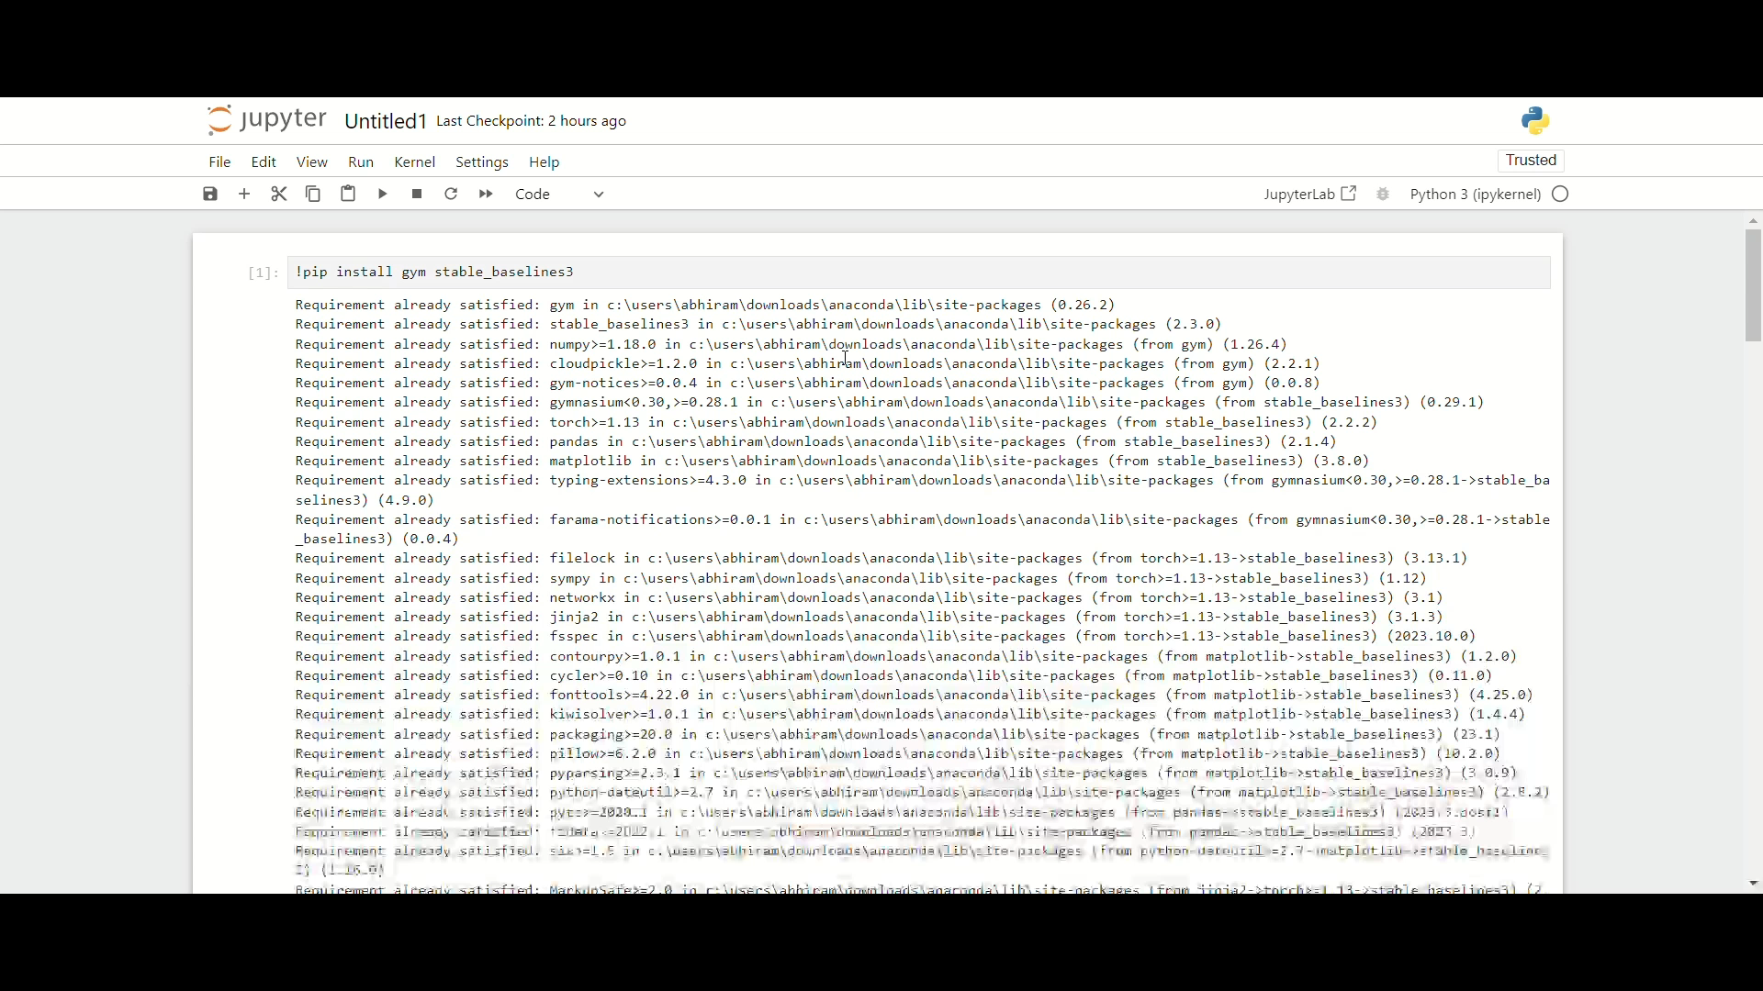
DEMO VIDEO OF CODE

Slide 13
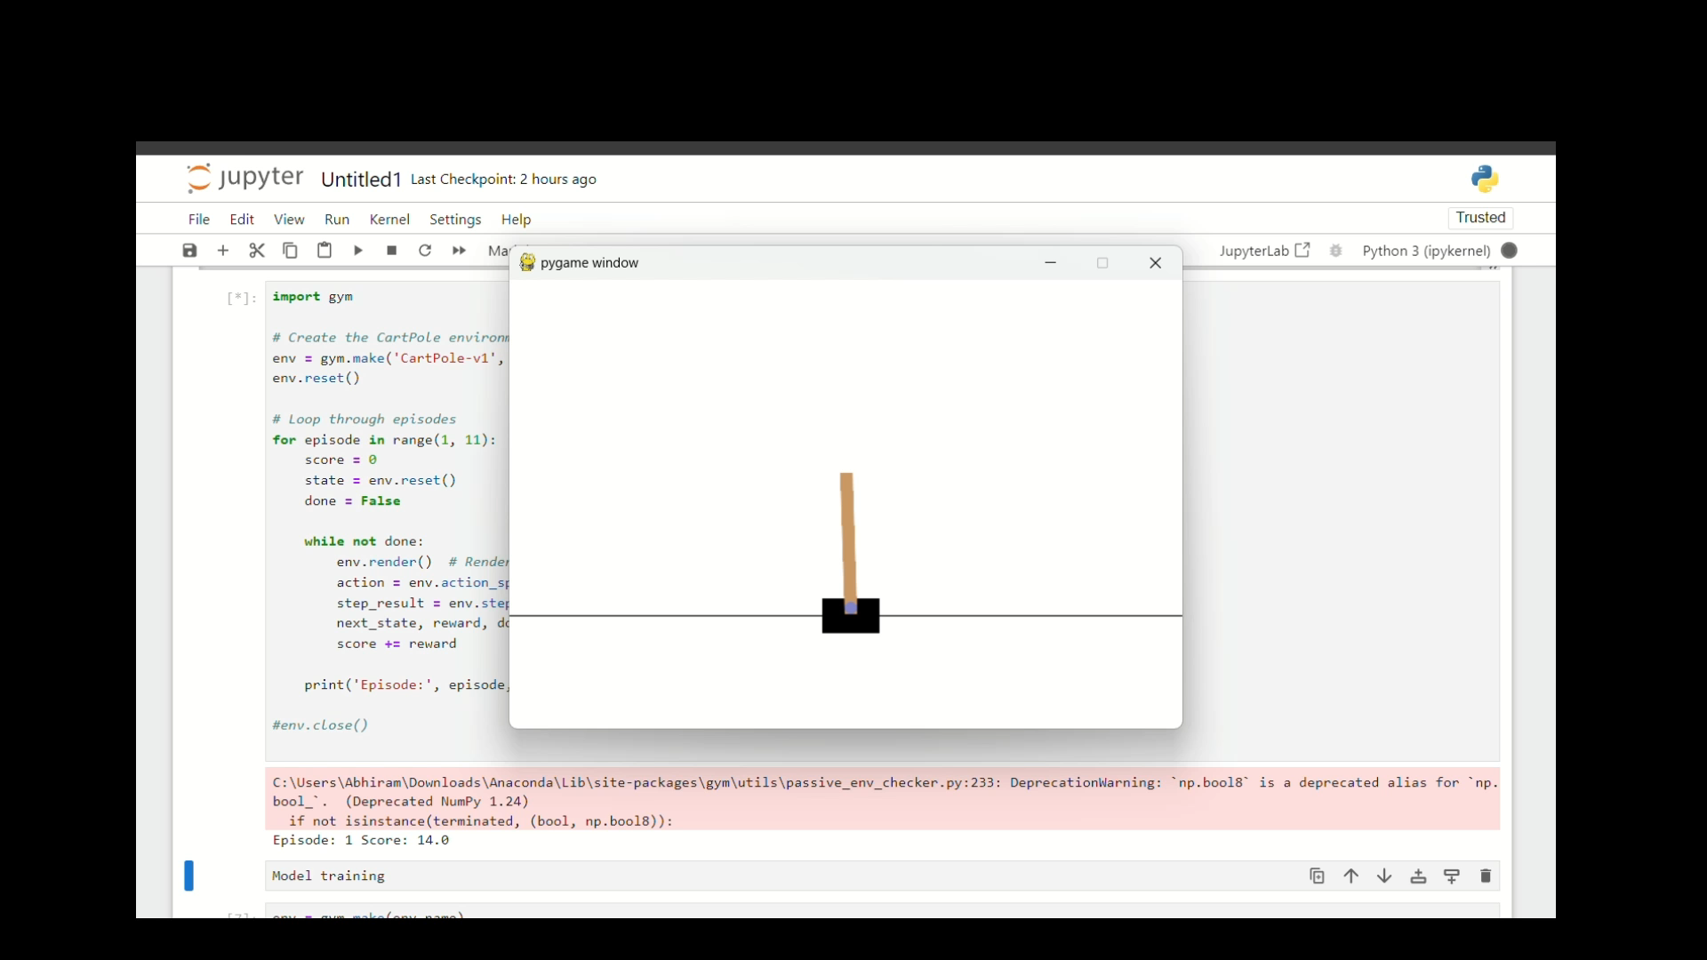
RESULT

Slide 14
REFERENCES
https://www.hackersrealm.net/
https://www.v7labs.com/blog/deep-reinforcement-learning-guide

